Slide 1

Problem Workshop II: Design and Optimization Using SU²
SU² Release Version 2.0 Workshop
Stanford University
Tuesday, January 15th, 2013
Dr. Francisco Palacios
Department of Aeronautics & Astronautics
Stanford University

Slide 2
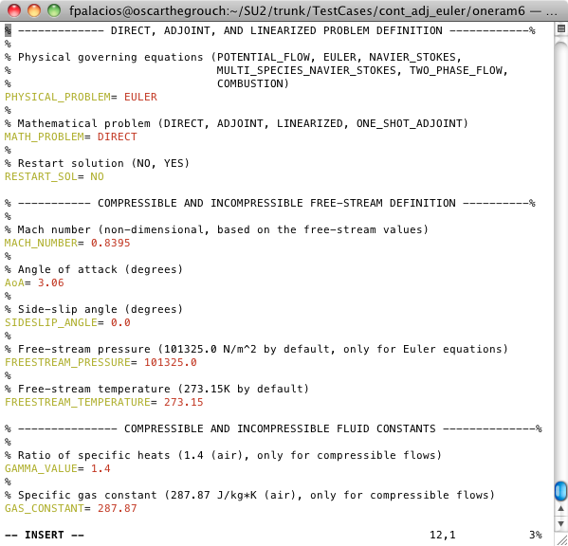

ONERA M6 Shape Optimization
Run direct, and rename the files (check non-dimensional parameters).
Run adjoint problems, and rename the files.
Visualize and check direct and adjoint solutions.
Identify corners of the FFD box and define the degree of the FFD box.
Run SU2_MDC to create the .su2 with FFD information (rename output .su2 file).
Define design variables and compute gradient.
Define optimization problem, objective function, constraints and final parameter check (restart ON).
Run the optimization.

Slide 3
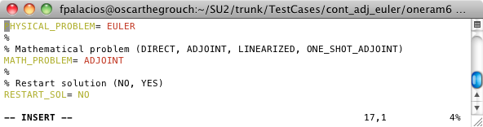
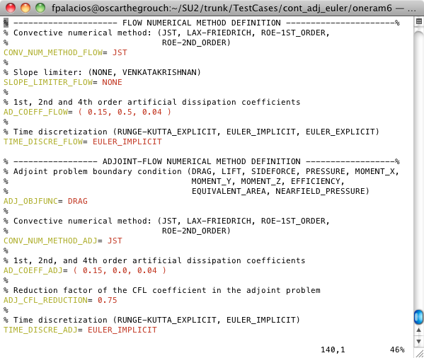
ONERA M6 Shape Optimization
Run direct, and rename the files (check non-dimensional parameters).
Run adjoint problems, and rename the files.
Visualize and check direct and adjoint solutions.
Identify corners of the FFD box and define the degree of the FFD box.
Run SU2_MDC to create the .su2 with FFD information (rename output .su2 file).
Define design variables and compute gradient.
Define optimization problem, objective function, constraints and final parameter check (restart ON).
Run the optimization.

Slide 4
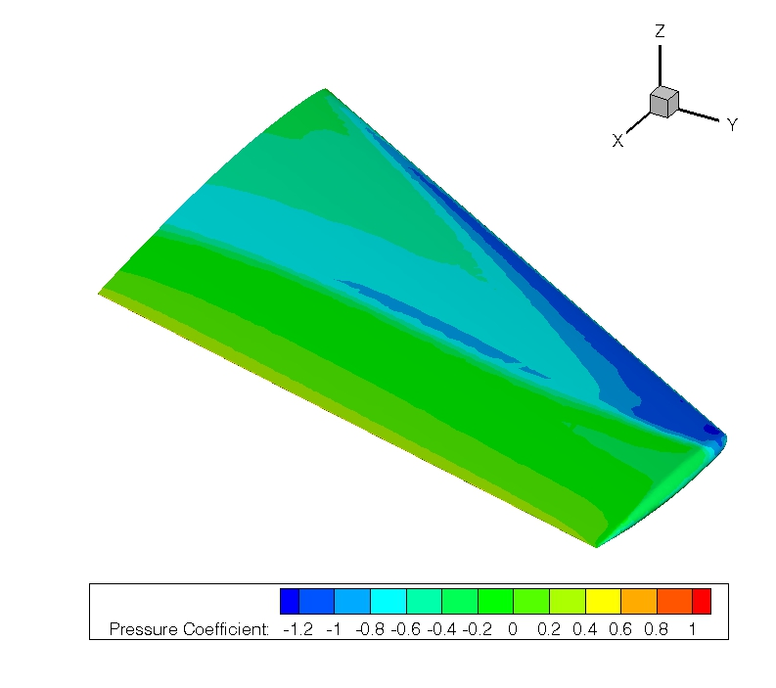
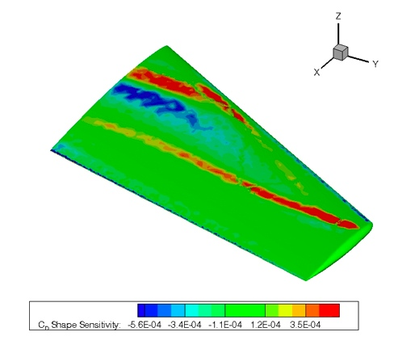
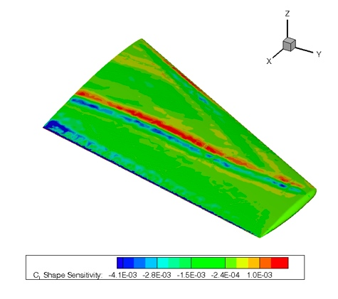
ONERA M6 Shape Optimization
Run direct, and rename the files (check non-dimensional parameters).
Run adjoint problems, and rename the files.
Visualize and check direct and adjoint solutions.
Identify corners of the FFD box and define the degree of the FFD box.
Run SU2_MDC to create the .su2 with FFD information (rename output .su2 file).
Define design variables and compute gradient.
Define optimization problem, objective function, constraints and final parameter check (restart ON).
Run the optimization.

Slide 5
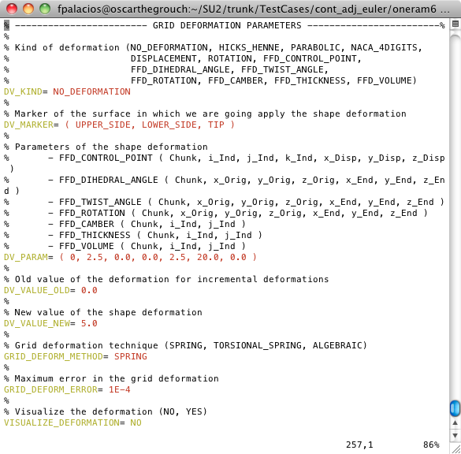
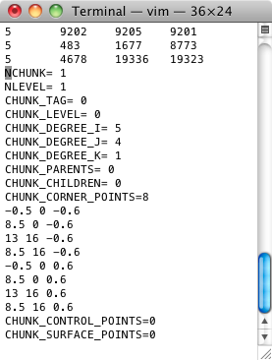
ONERA M6 Shape Optimization
Run direct, and rename the files (check non-dimensional parameters).
Run adjoint problems, and rename the files.
Visualize and check direct and adjoint solutions.
Identify corners of the FFD box and define the degree of the FFD box.
Run SU2_MDC to create the .su2 with FFD information (rename output .su2 file).
Define design variables and compute gradient.
Define optimization problem, objective function, constraints and final parameter check (restart ON).
Run the optimization.

Slide 6
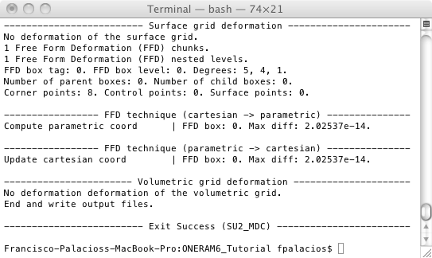
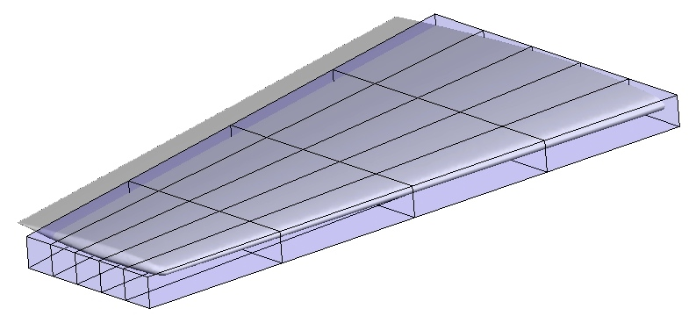
ONERA M6 Shape Optimization
Run direct, and rename the files (check non-dimensional parameters).
Run adjoint problems, and rename the files.
Visualize and check direct and adjoint solutions.
Identify corners of the FFD box and define the degree of the FFD box.
Run SU2_MDC to create the .su2 with FFD information (rename output .su2 file).
Define design variables and compute gradient.
Define optimization problem, objective function, constraints and final parameter check (restart ON).
Run the optimization.

Slide 7
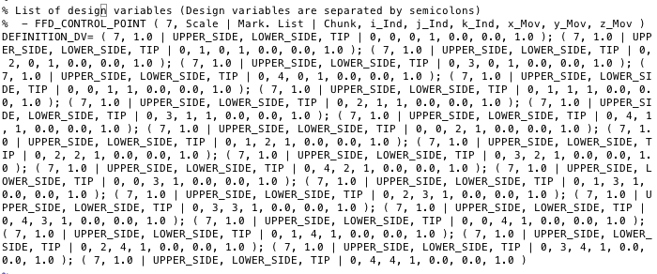
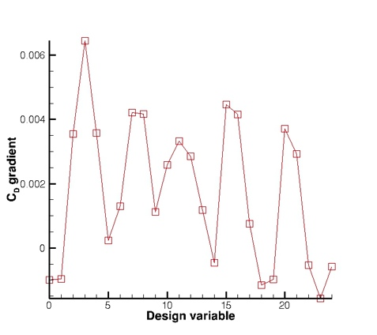
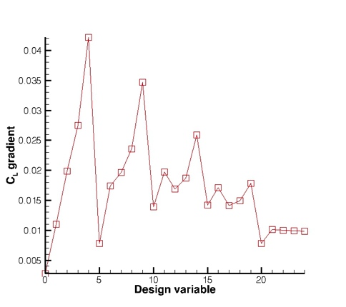
ONERA M6 Shape Optimization
Run direct, and rename the files (check non-dimensional parameters).
Run adjoint problems, and rename the files.
Visualize and check direct and adjoint solutions.
Identify corners of the FFD box and define the degree of the FFD box.
Run SU2_MDC to create the .su2 with FFD information (rename output .su2 file).
Define design variables and compute gradient.
Define optimization problem, objective function, constraints and final parameter check (restart ON).
Run the optimization.

Slide 8
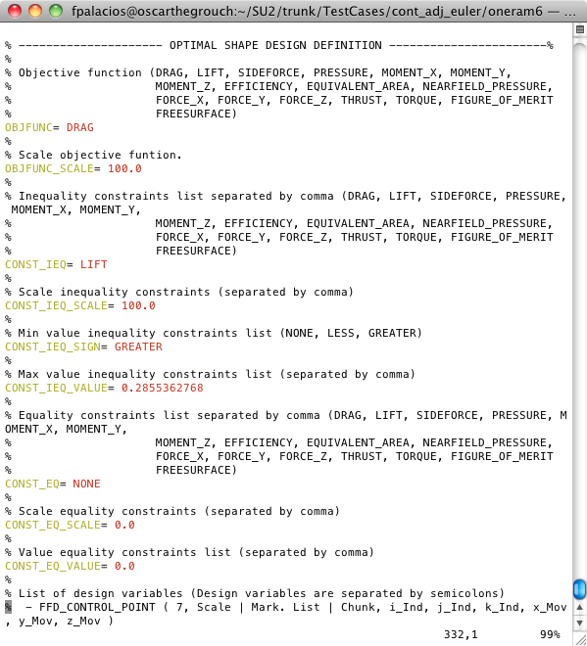
ONERA M6 Shape Optimization
Run direct, and rename the files (check non-dimensional parameters).
Run adjoint problems, and rename the files.
Visualize and check direct and adjoint solutions.
Identify corners of the FFD box and define the degree of the FFD box.
Run SU2_MDC to create the .su2 with FFD information (rename output .su2 file).
Define design variables and compute gradient.
Define optimization problem, objective function, constraints and final parameter check (restart ON).
Run the optimization.

Slide 9
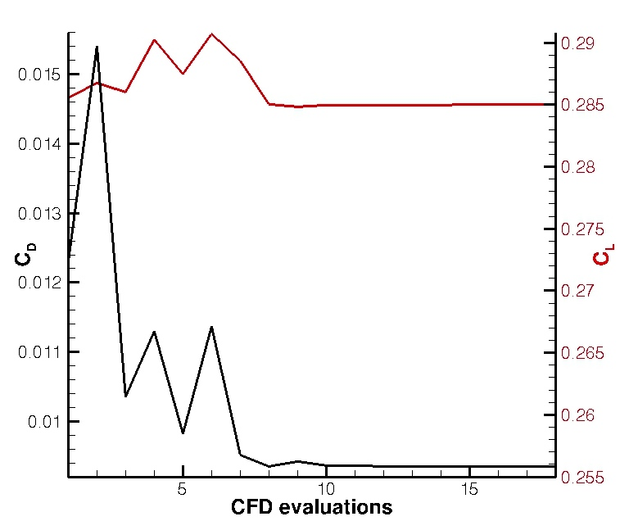
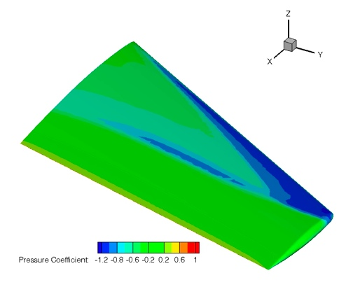
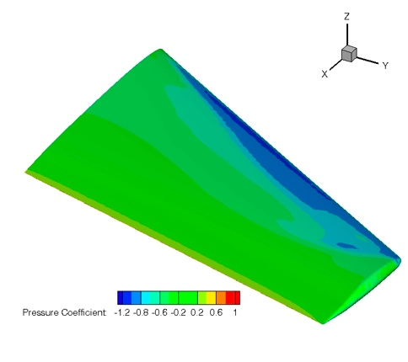
ONERA M6 Shape Optimization
Run direct, and rename the files (check non-dimensional parameters).
Run adjoint problems, and rename the files.
Visualize and check direct and adjoint solutions.
Identify corners of the FFD box and define the degree of the FFD box.
Run SU2_MDC to create the .su2 with FFD information (rename output .su2 file).
Define design variables and compute gradient.
Define optimization problem, objective function, constraints and final parameter check (restart ON).
Run the optimization.

